Slide 1
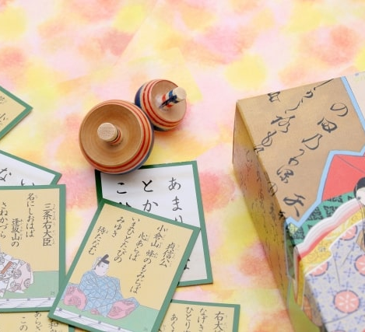
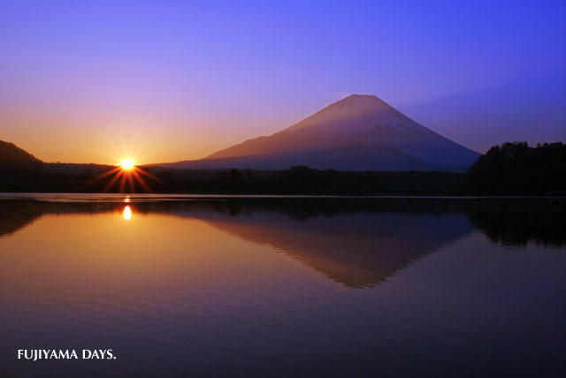
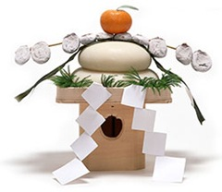
Oshogatsu
New Year’s Day
Notes:
Ok, it is time for our presentation.
Today’s theme is Oshogatsu, the beginning of the new year.
We are happy if you find new information through this presentation.
Let us start it now!

Slide 2

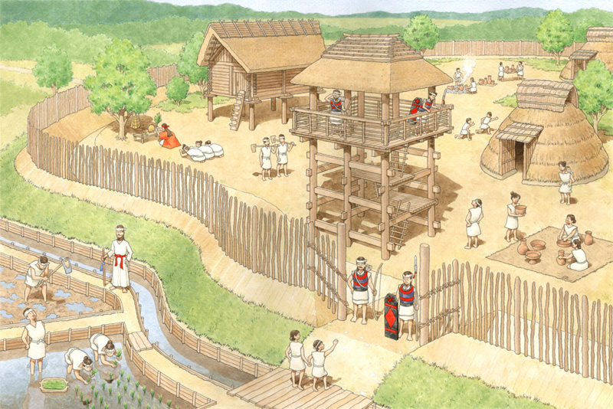
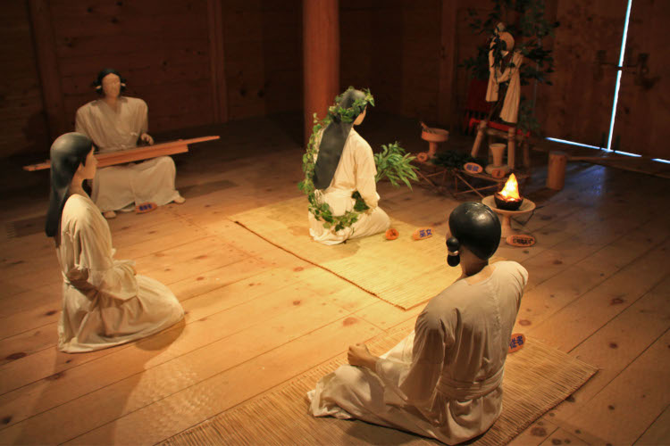
When did Oshogatsu start?
Oshogatsu is the oldest event in Japan.
About 2500 years ago?
Notes:
When did Oshogatsu start?
Of all the remaining events in Japan, Oshogatsu has the longest history and has existed for quite some time.
It is said that Oshogatsu already existed when Buddhism was introduced to Japan 1,500 years ago.
Due to its ancient history, unfortunately the exact origin is still unknown, but some people said that Oshogatsu started 2,500 years ago.

Slide 3
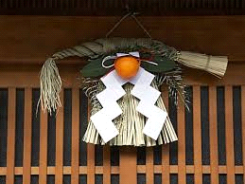
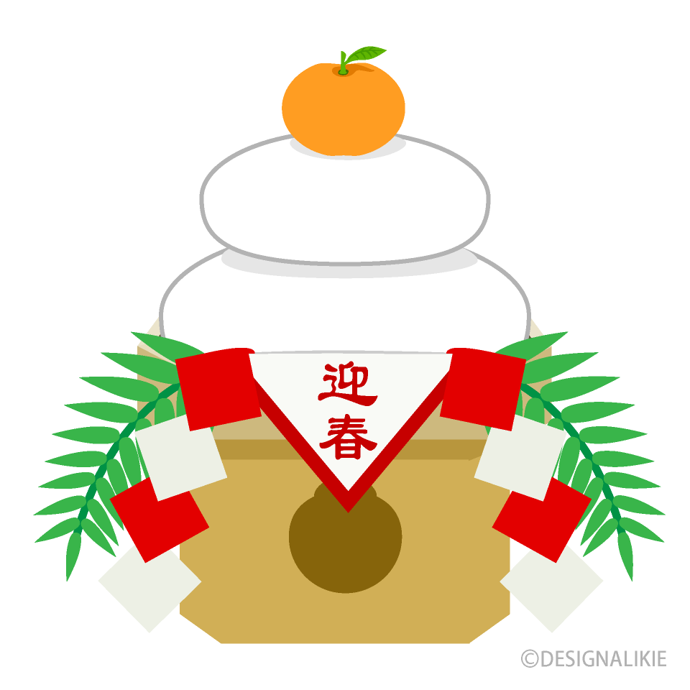
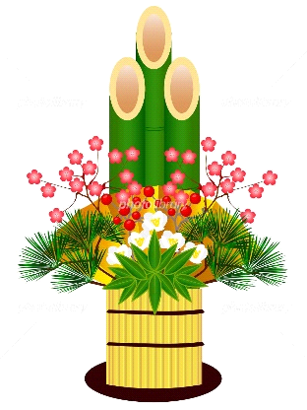
What is Oshogatsu for?
New year’s god
Shime-kazari
Kado-matsu
Oshogatsu is the event
to welcome New year’s god
Th
Kagami-mochi
Notes:
Oshogatsu is the event to welcome New year's god.
In the past, Oshogatsu was also a time to give thanks to ancestors and worship their spirits, like what we call Obon today.
However, with the arrival of Buddhism in Japan, Obon became a Buddhist event, and Oshogatsu became the event to welcome New year's god presiding the harvest.
The custom of decorating Shime-kazari, Kado-matsu and Kagami-mochi, which we will explain later, and the custom of cleaning houses are for welcoming New year’s god.
In other words, even today, we unknowingly perform rituals to thank, welcome, and enshrine New year’s god.
Incidentally, it is said that the phrase "Akemashite omedegami gozaimasu" meaning ‘Happy New Year’ was once a congratulatory prayer to welcome New year’s god.

Slide 4
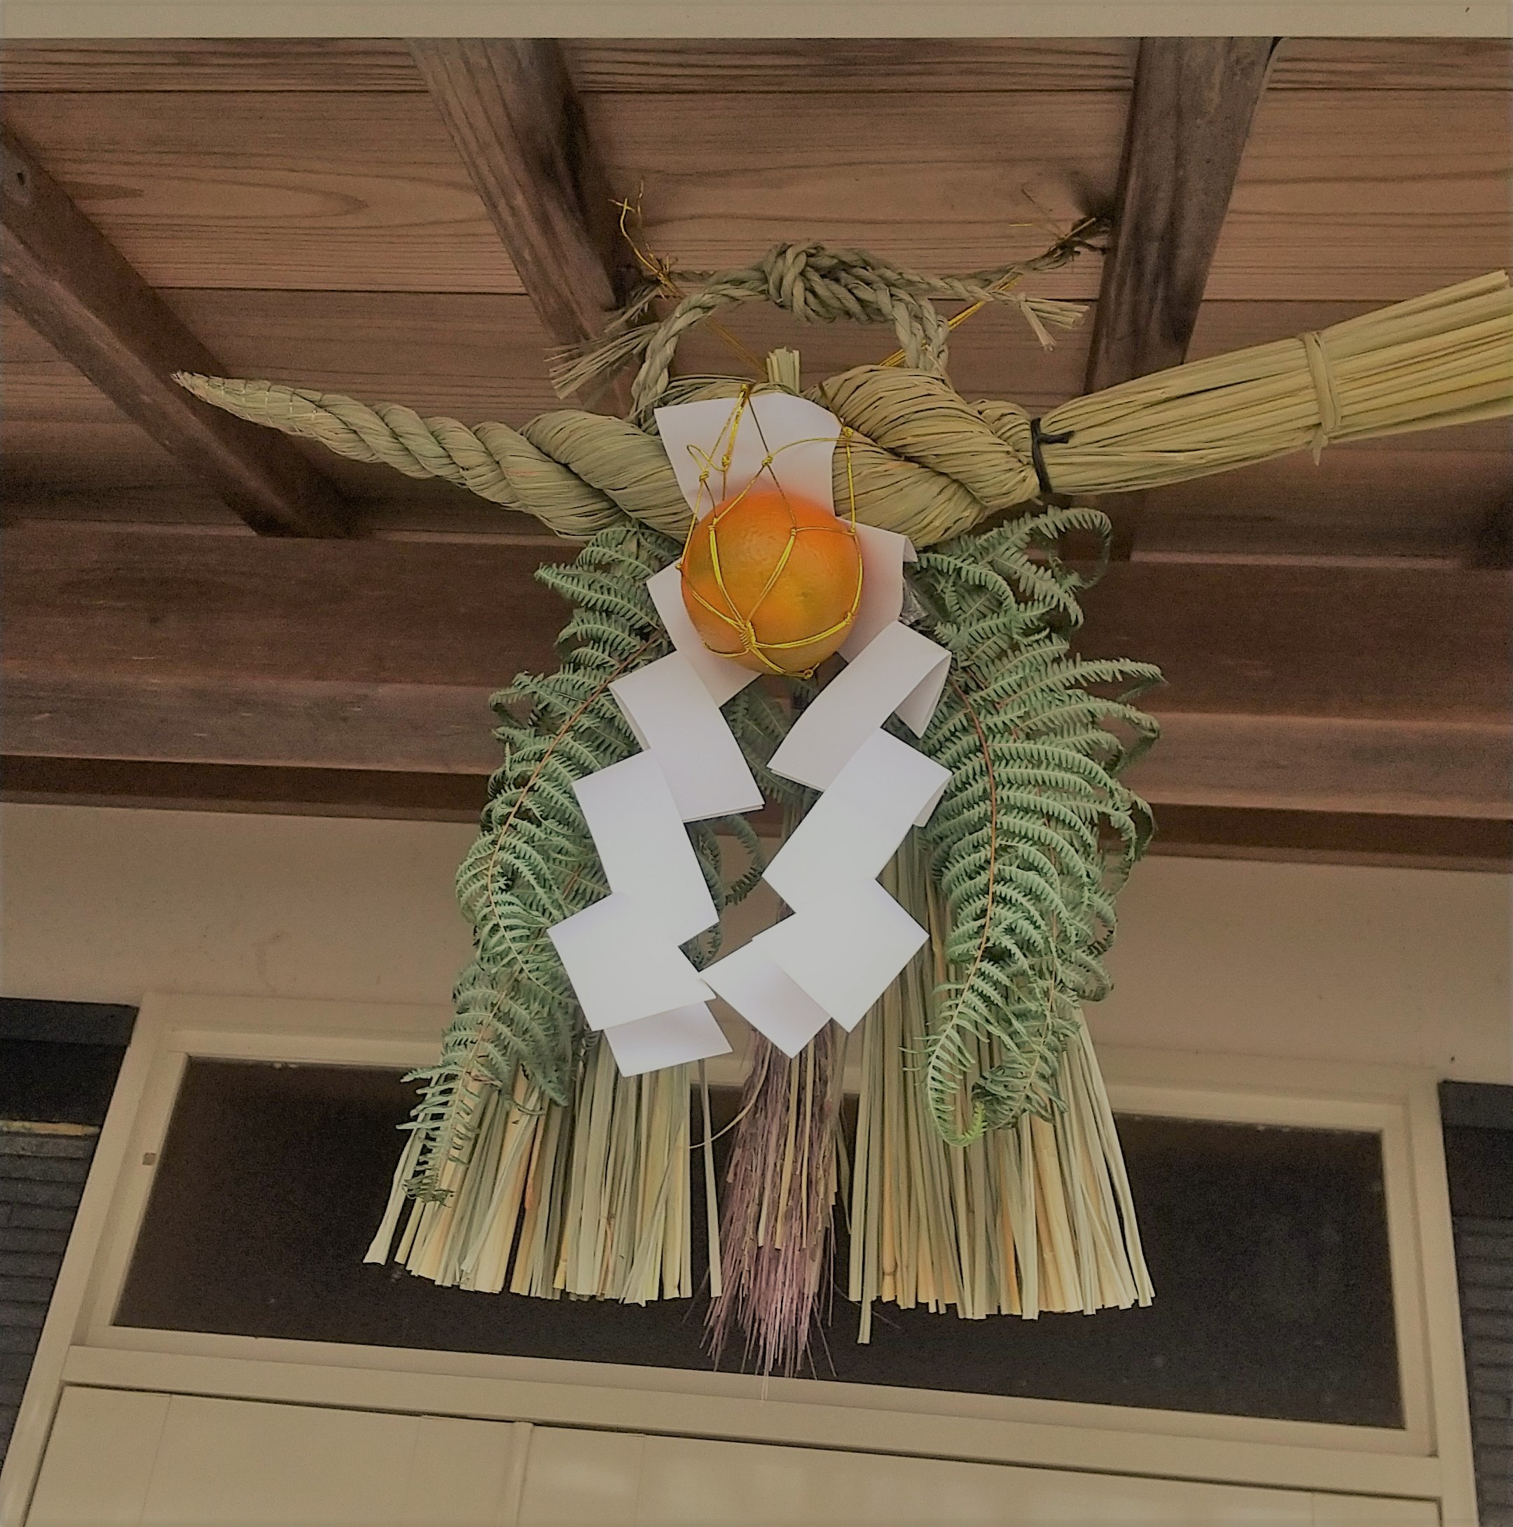
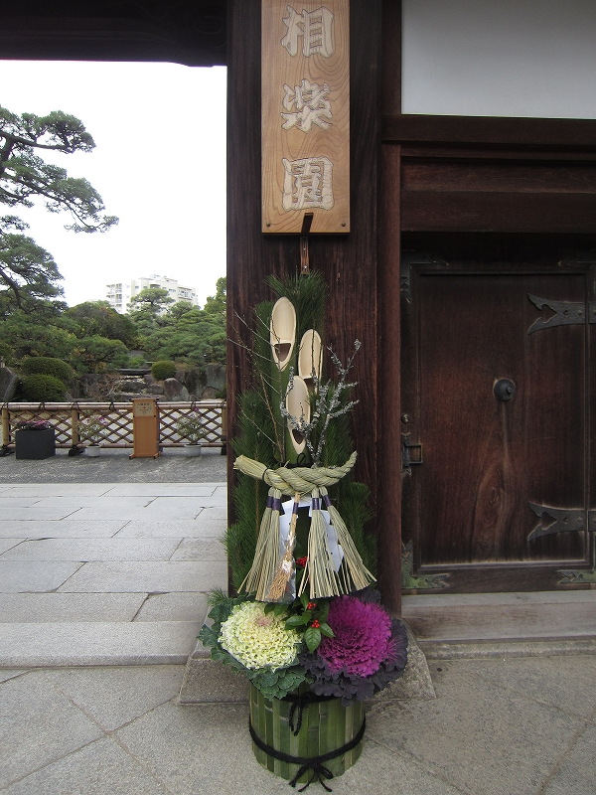
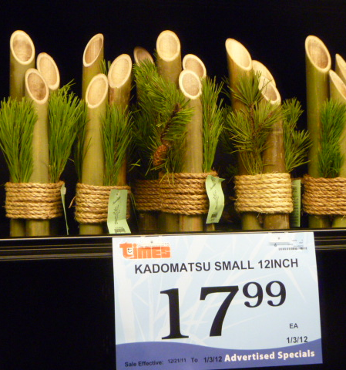

Shime-kazari Kado-matsu
Notes:
I’ll talk about entrance decorations of my house for Oshogatsu, shime-kazari and kado-matsu.

Slide 5
Shime-kazari
Notes:
We prepare shime-kazari for the entrance threshold to welcome New Year’s god who brings happiness for new year.
Shime-kazari traditionally consists of shimenawa: enclosing rope, shide: folded white paper, daidai orange, uraziro ferns and ears of rice.

Slide 6
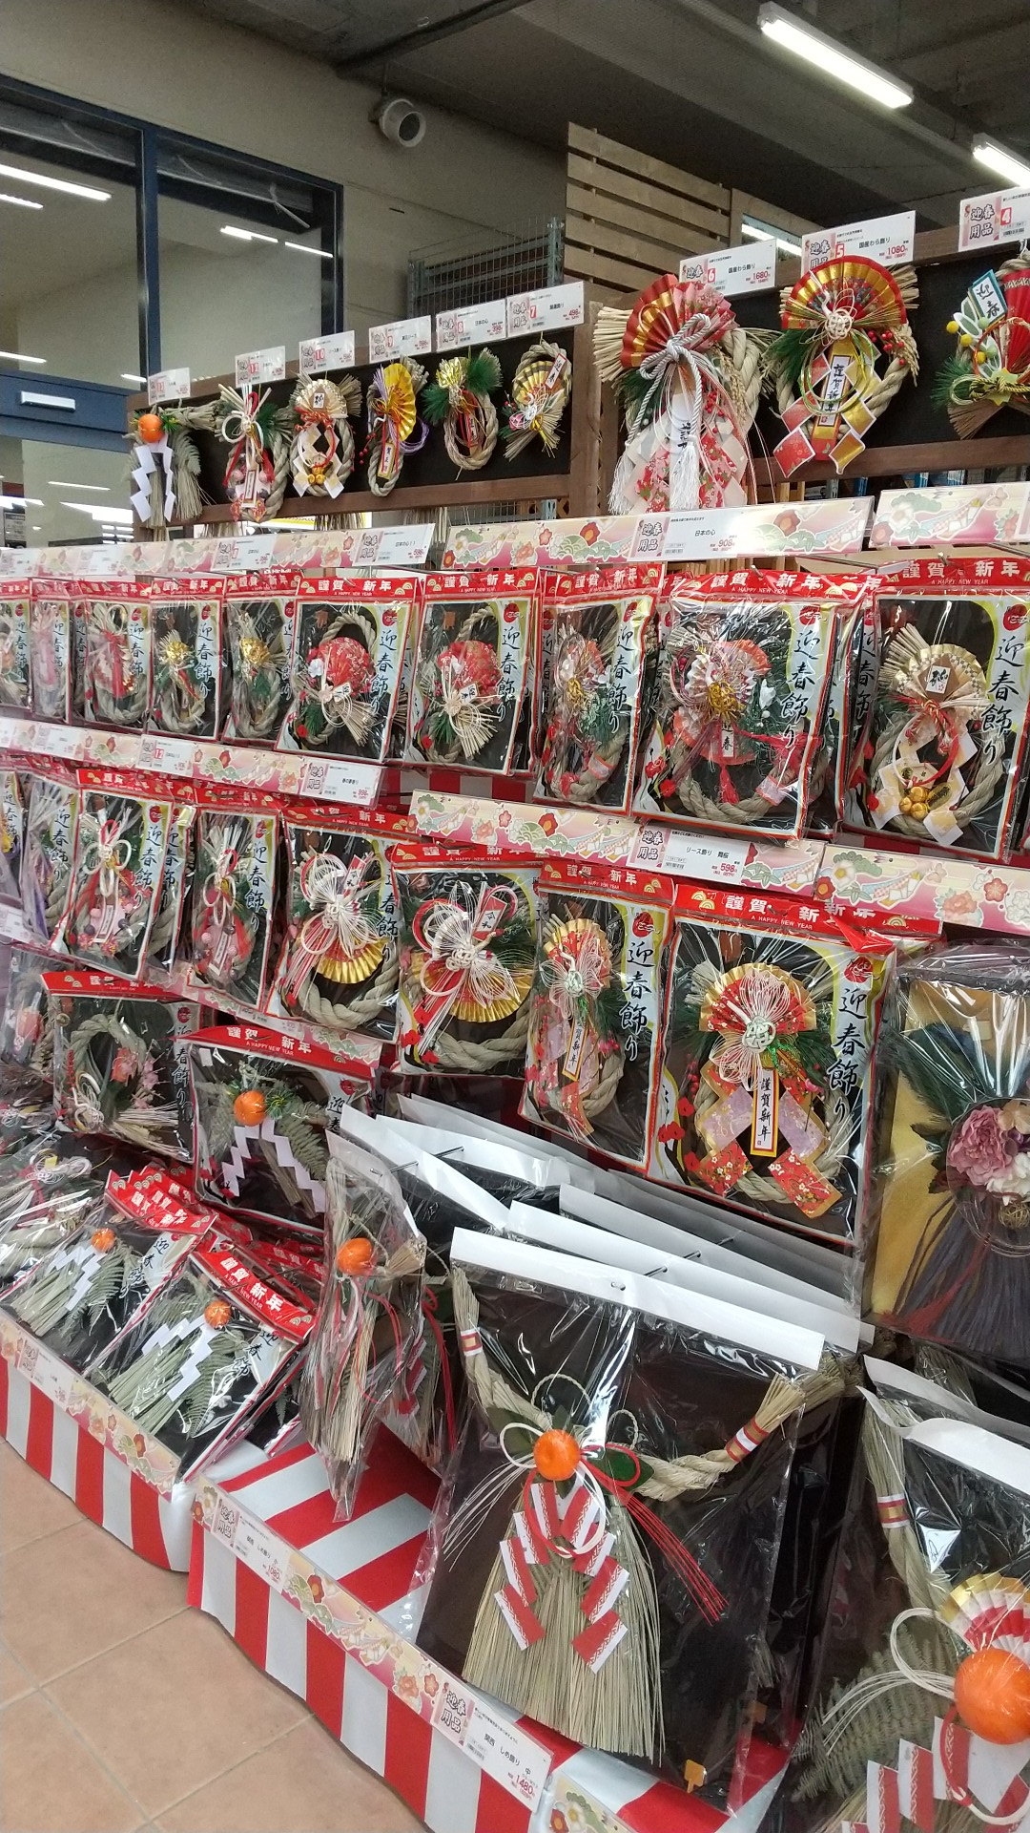
Notes:
Recently new shime-kazari like wreaths are sold at stores.

Slide 7
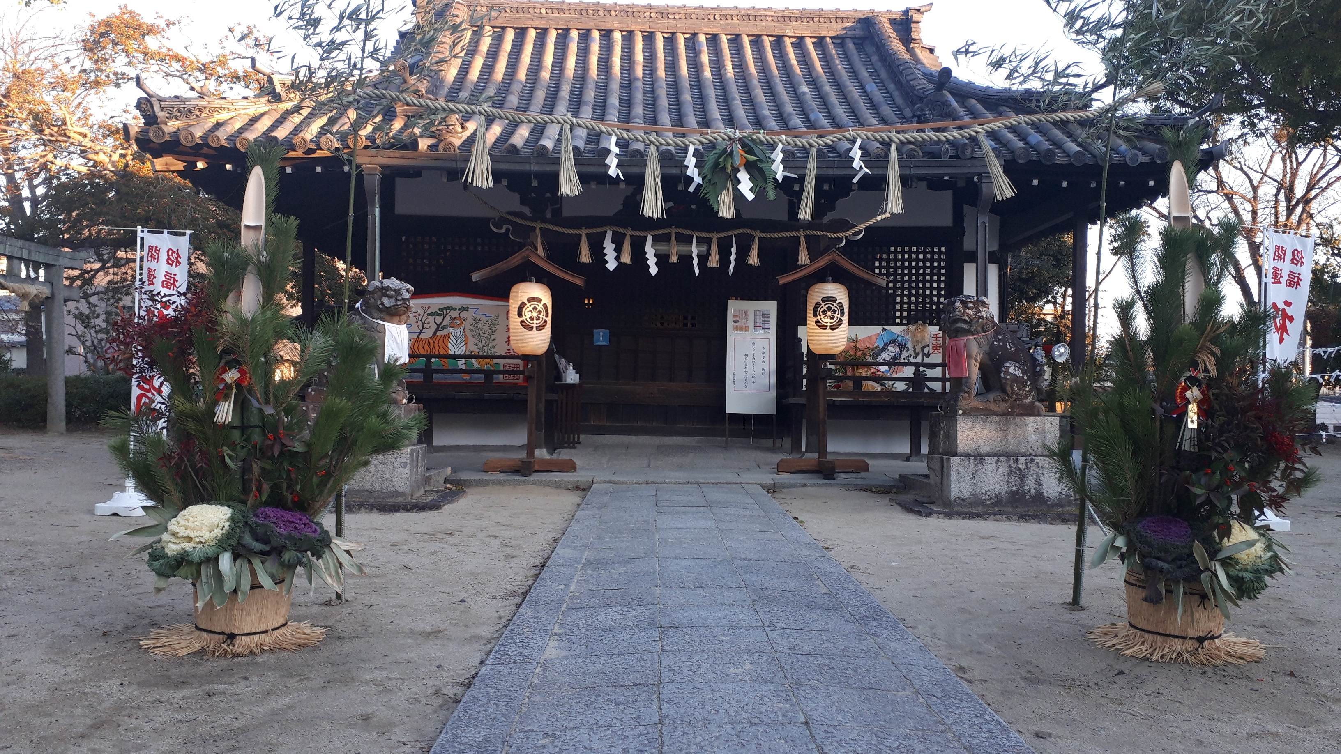
Kado-matsu
Notes:
Kado-matsu, gate pine are placed in front of shrines, offices, stores and houses during Oshogatsu.
Matsu, a pine tree, considered a sacred tree where god stay is a main item of kado-matsu.
Designs for kado-matsu vary depending on regions but are typically made of pines, bamboos and sometimes plum sprigs which represent longevity, prosperity and steadfastness, respectively.

Slide 8
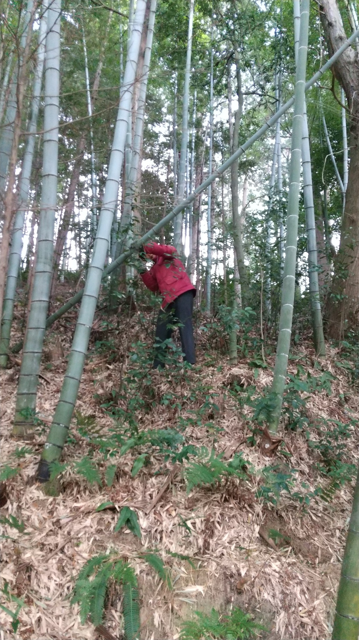
Notes:
There are many bamboos around my house, so we make kado-matsu by ourselves.
First my husband cuts down a bamboo. From it, he cuts out six pieces of bamboo.

Slide 9
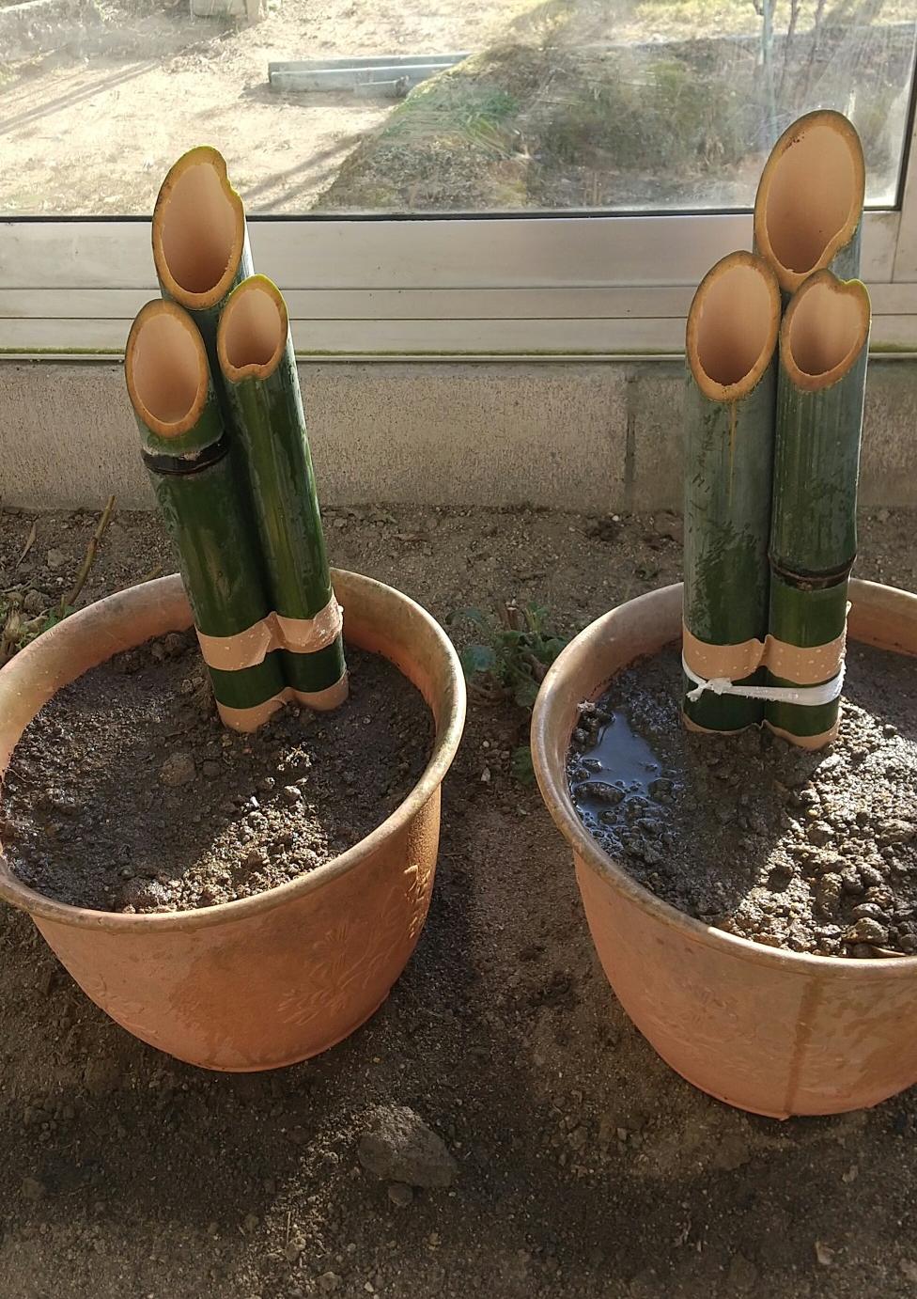
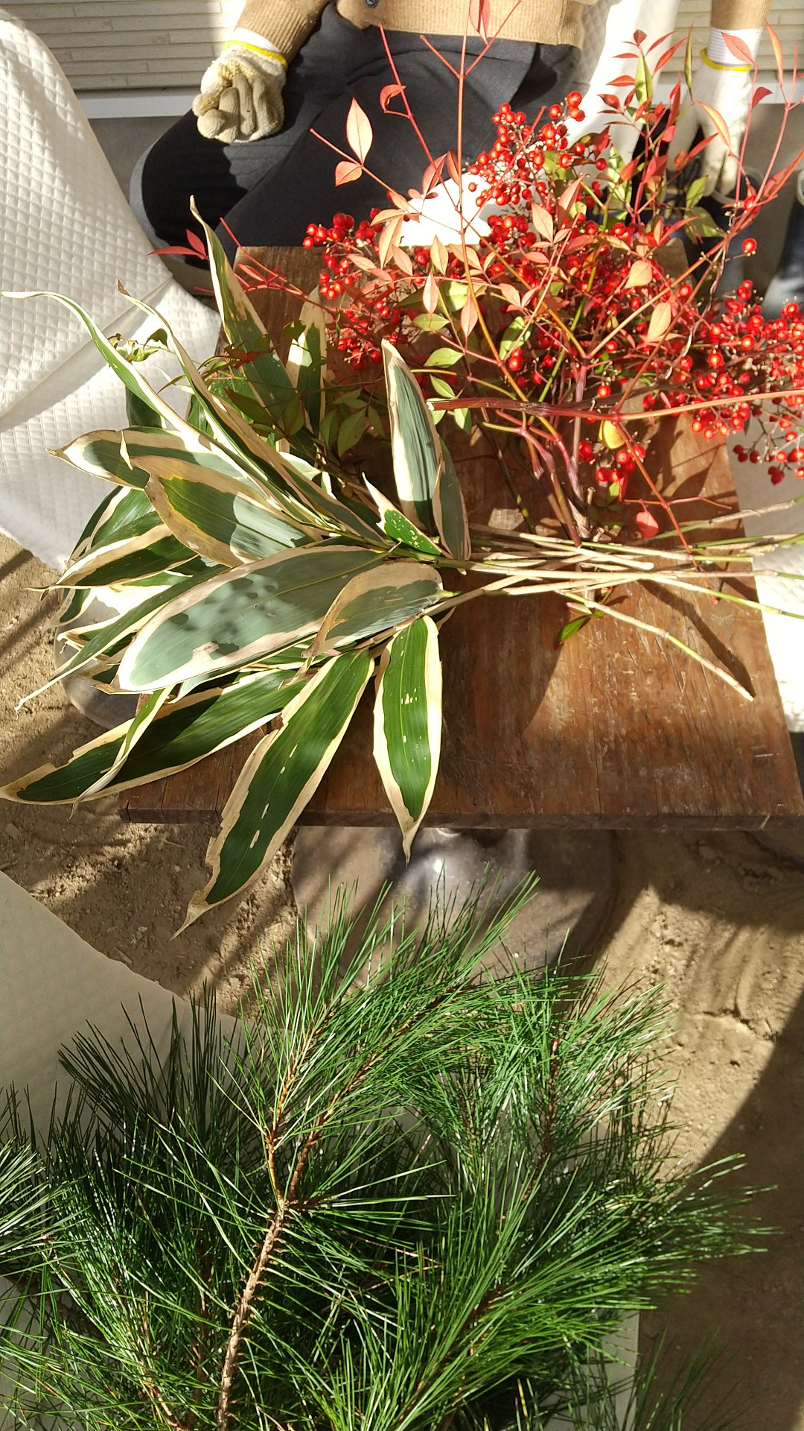
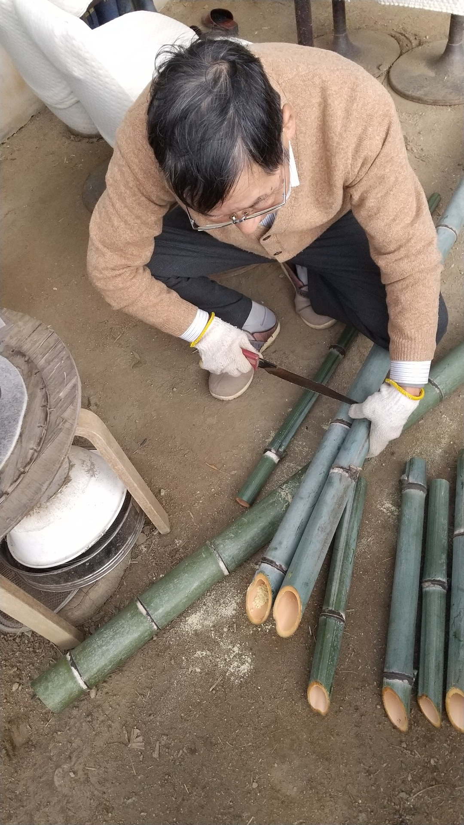
Notes:
The most difficult parts of making kado-matsu are to cut bamboos diagonally and bind them with a rope.
The bamboos’ height are different, the highest represents heaven, middle humanity,
the lowest the earth. Some people place bamboos of humanity and the earth the same height.
Bamboos are set in the center, adding pine branches, red and white ornamental cabbages, nanten and kumazasa.

Slide 10
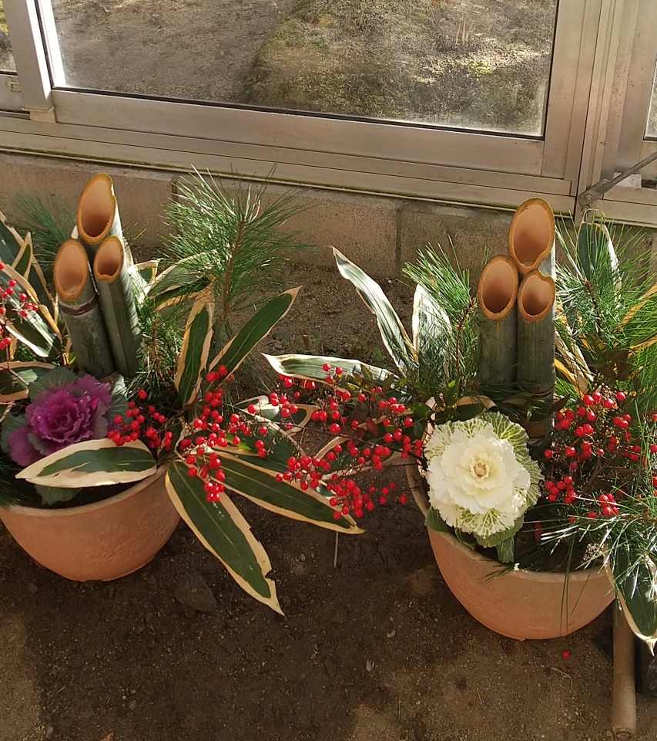
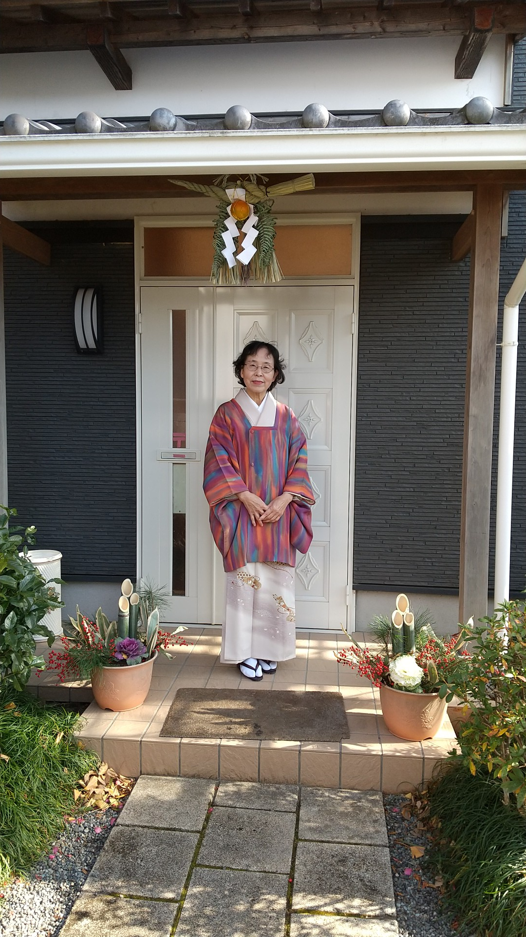
Notes:
These are our kadomatsu.
Me in front of my house on Oshogatsu with kado-matsu and shime-kazari.

Slide 11
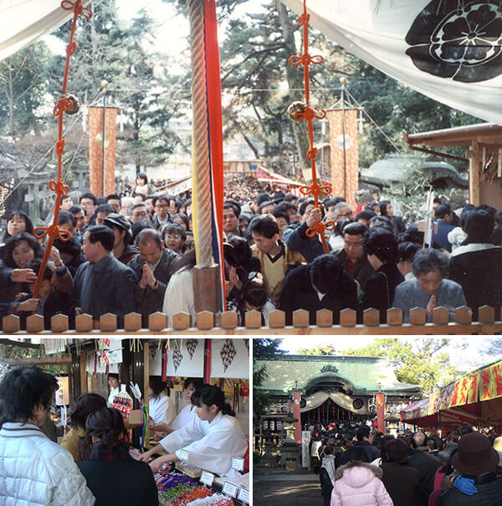
70％ of the Japanese visit
shrines and
temples.
Notes:
In the first three days of Oshogatsu, about 70% of Japanese people go to visit shrines or temples to pray for the new year’s happiness, so called Hatsu-moude.

Slide 12
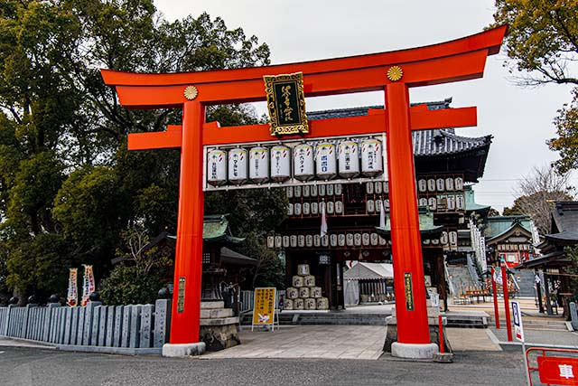
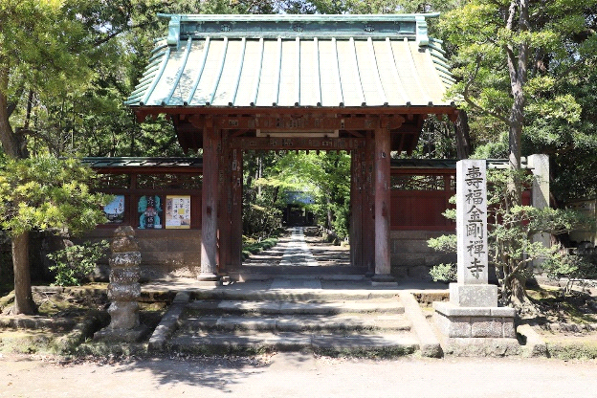

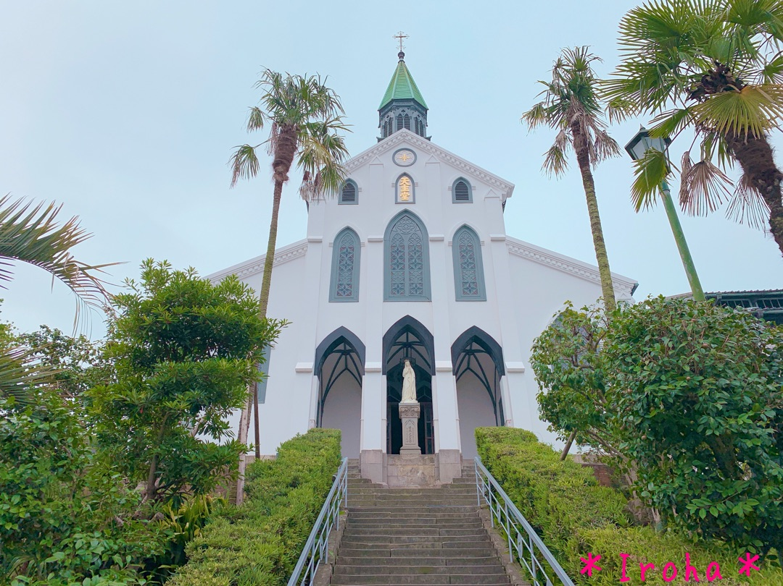
Notes:
By the way, how many shrines or temples do you think there are in Japan? How many convenience stores? How many churches for Christians?
81,000 Shrines are here. 77,000 Buddhist temples are in Japan. 56,000 convenience stores are here in Japan.
However, there are only 5,800 churches.
This is an interesting number that reflects the historical background of Japan.

Slide 13
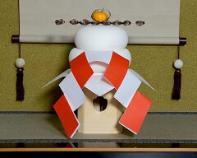
Kagami-mochi
Notes:
Each family prepares to welcome Oshogatsu, and here are some of the unique ways to do so.
Kagami-mochi
Kagami-mochi is a set of round rice cakes piled up in two layers.
Originally, Oshogatsu events are held to welcome the New year’s god called “Toshi-Gami-Sama” into a house and are to entertain the god until sending him off.
During Oshogatsu, Toshi-Gami-Sama stays in Kagami-mochi.

Slide 14
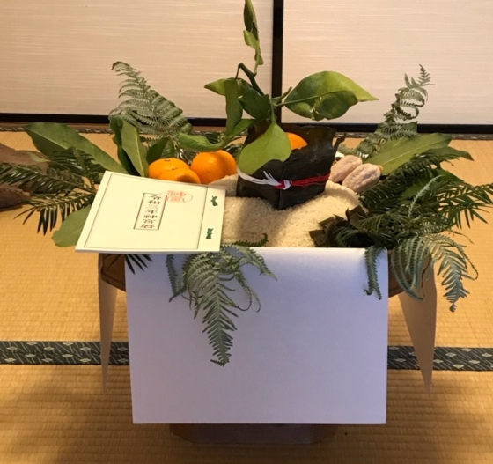
Horai-kazari
(Horai decoration)
Notes:
Horai-kazari
It is similar to the way Kagami-mochi is made. Rice is used for decoration instead of rice cakes.
The rice is made in the shape of Holy Mt. Horai with the quantity of eight cups of rice because ten cups of it are too much.
It preaches us if it fills, it will be missing, or be modesty.
In this Shinto priest’s house, a special calendar is offered with the decoration.

Slide 15
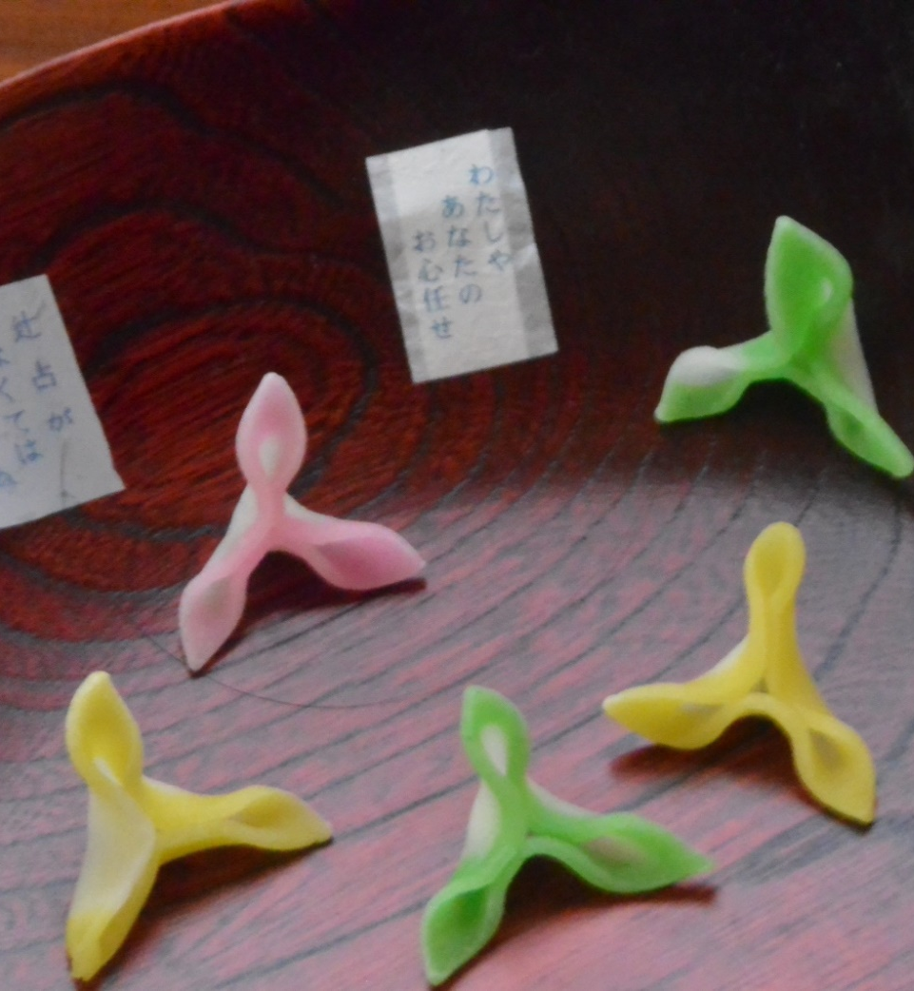
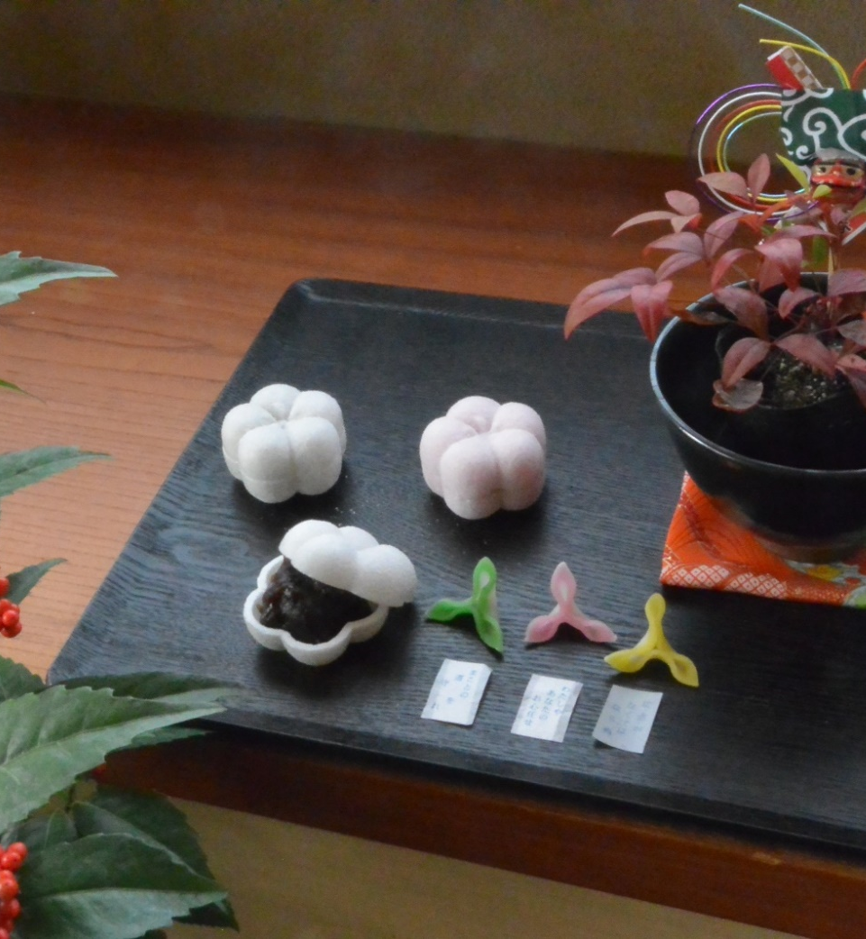
Tsuji-ura (fortune telling)
Fuku-ume
Sweets
Notes:
Sweets
Now I will show you the essential sweets in Kanazawa.
Fuku-ume
They are Oshogatsu confectioneries that resembles the crest of the domain of Kaga, "sword and plum bowl."
They are classic good-luck sweets with red color and white one. Red bean paste is filling inside of it and the skins covered with powdered sugar.
Fuku-Ume is popular there.
Tsujiura (fortune-telling)
It is a cute confectionery containing a small piece of paper that tells your fortune. Simple words of good luck are written on it.
Before having the O-sechi everyone reads it out together and has the first laugh.

Slide 16
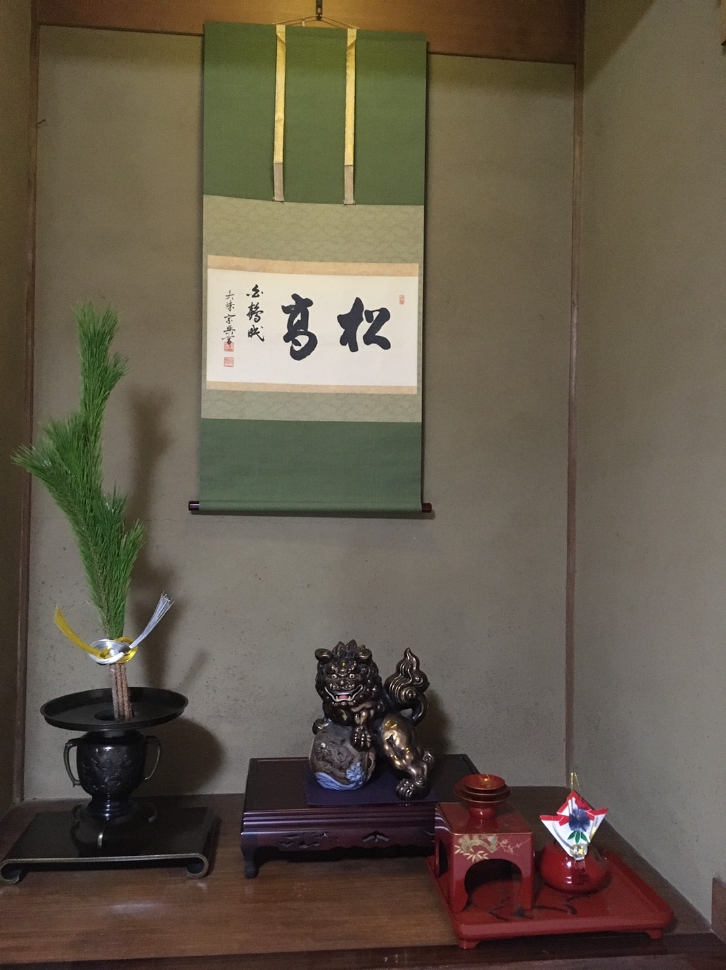
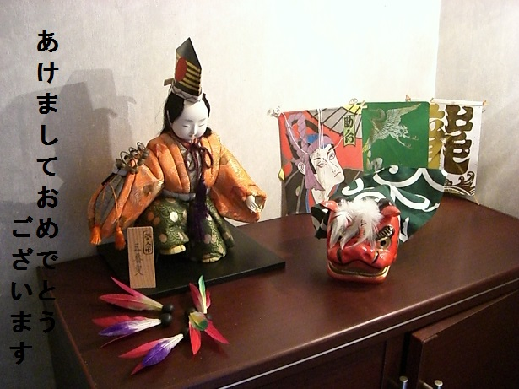
Ornaments
Notes:
Ornaments
Each family celebrates Oshogatsu with their own traditional decorations.

Slide 17
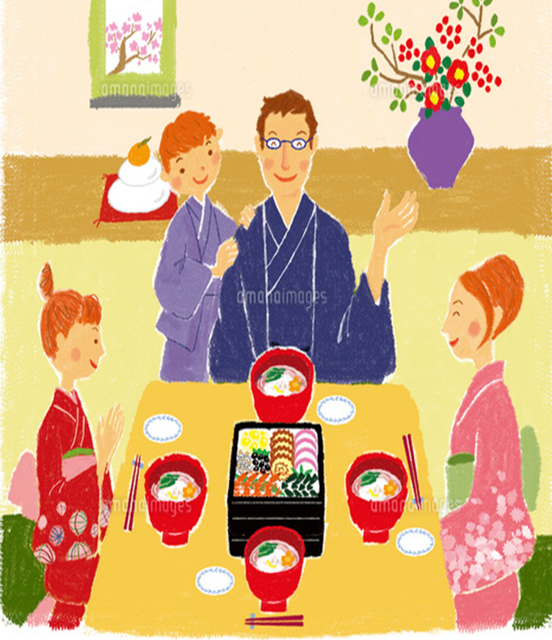
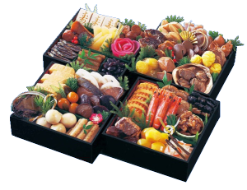
Osechi
Notes:
I’ll introduce what are Osechi dishes that Japanese people traditionally eat on New Year.
On Oshogatsu our family members and other relatives get together and eat Japanese traditional dishes called “Osechi” and “Ozouni” to pray for good health and great harvest for the New Year.

Slide 18
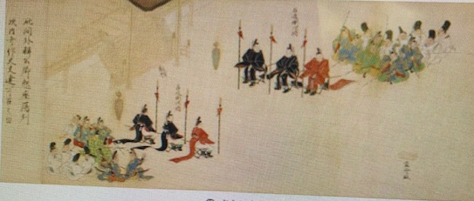
Notes:
What is Osechi?
The history of Osechi came from China during Nara period (8th century).
Since ancient times, the Japanese court has held a feast called “Sechie” at the turn of the season.
At that time, the dishes prepared were called “Osechi”, but people now say Osechi only to mean what is prepared for the New Year.

Slide 19
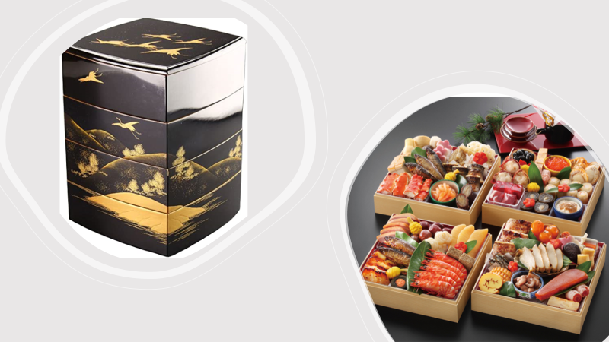
Notes:
Then why was the Osechi made?
On New Year days, it is customary to avoid cooking with fire to welcome the deities and in order to reduce the household chores of women, and most Osechi dishes are long-lasting food.
Various kind of beautifully-prepared dishes are served in four-stacked lacquer
boxes.
The top box is filled with three celebration dishes such as black beans, herring roe, and tazukuri (dried and caramelized young anchovies) in addition to sweet-flavored dishes such as datemaki (sweet rolled omelet).
The second box is filled with sweet food and vinegared food.
The third box is filled with grilled food such as fish.
The fourth box is filled with simmered food.

Slide 20
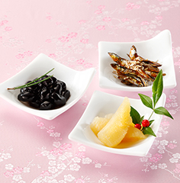
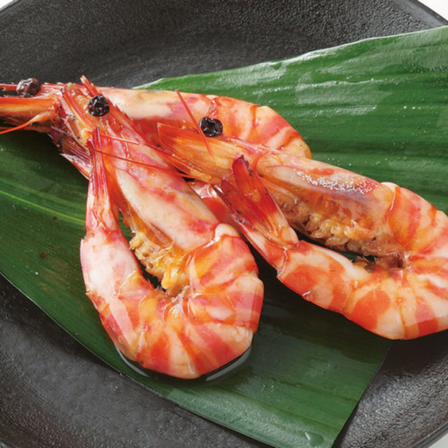
Dried sardine
Lobster
Cooked black beans
Herring roe
Notes:
Each of the dishes has some auspicious meaning which reflects people wishes.
I’ll explain a few of the food meaning.
Kazunoko, herring roe, represents fertility because of many lots of eggs.
Kuromame, cooked black beans are considered effective for driving out evil spirits.
Lobsters are for longevity because their bodies are bent like an old age.
Tazukuri is dried sardine cooked down with sweet cooking sake, sugar and soy sauce.
It has meaning of rich harvest.
Although there are some regional differences in the contents of Osechi, most of them are common to all parts of Japan.

Slide 21
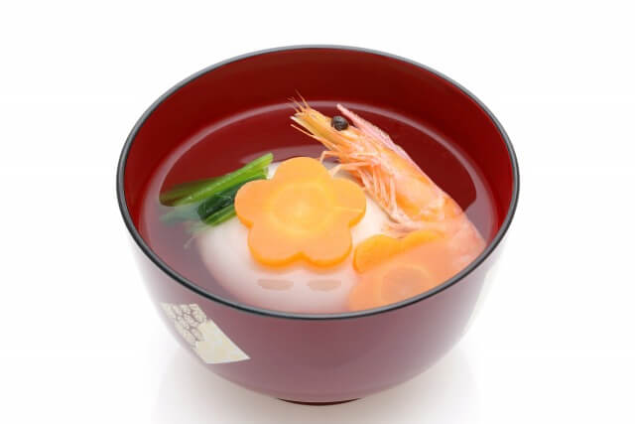
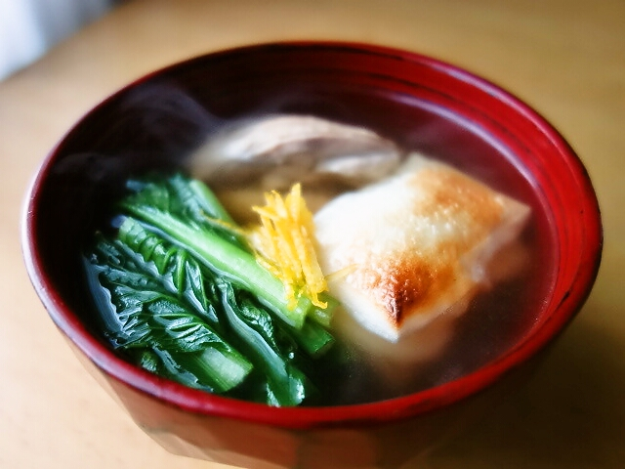
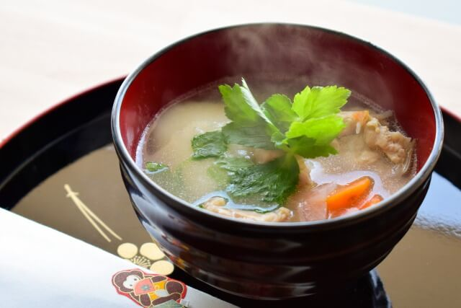
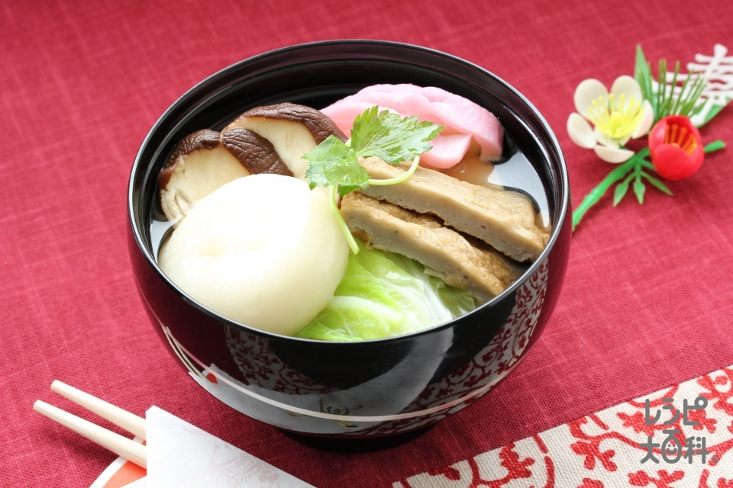
O-zōni
Clear soup and
square shape mochi
in eastern Japan
Miso soup and
round shape mochi
in western Japan
Notes:
Ozoni is a rice cake and vegetable soup and one of the most popular New Year dishe.
Rice cake has long been a food for celebrating and special occasions for Japanese people.
It is said that the origin of Ozoni is that the rice cake and vegetables offered to deity were boiled and eaten on New Year’s Day.
The meaning of “zouni” in Japanese is to boil various ingredients.
Ozoni can take on different forms region to region and also varies from
region to region.
Square rice cakes are often used in eastern Japan and round rice cakes are often used in western Japan.
Ozoni in the region in eastern Japan is usually a clear soup base.
A white miso soup is used to make Ozoni in the western Japan region.

Slide 22

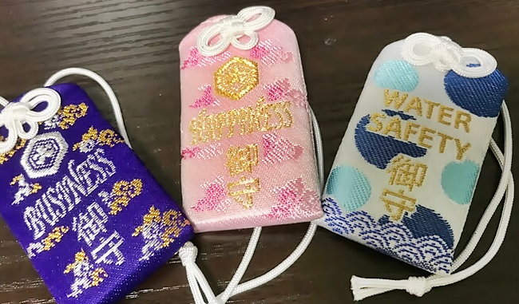
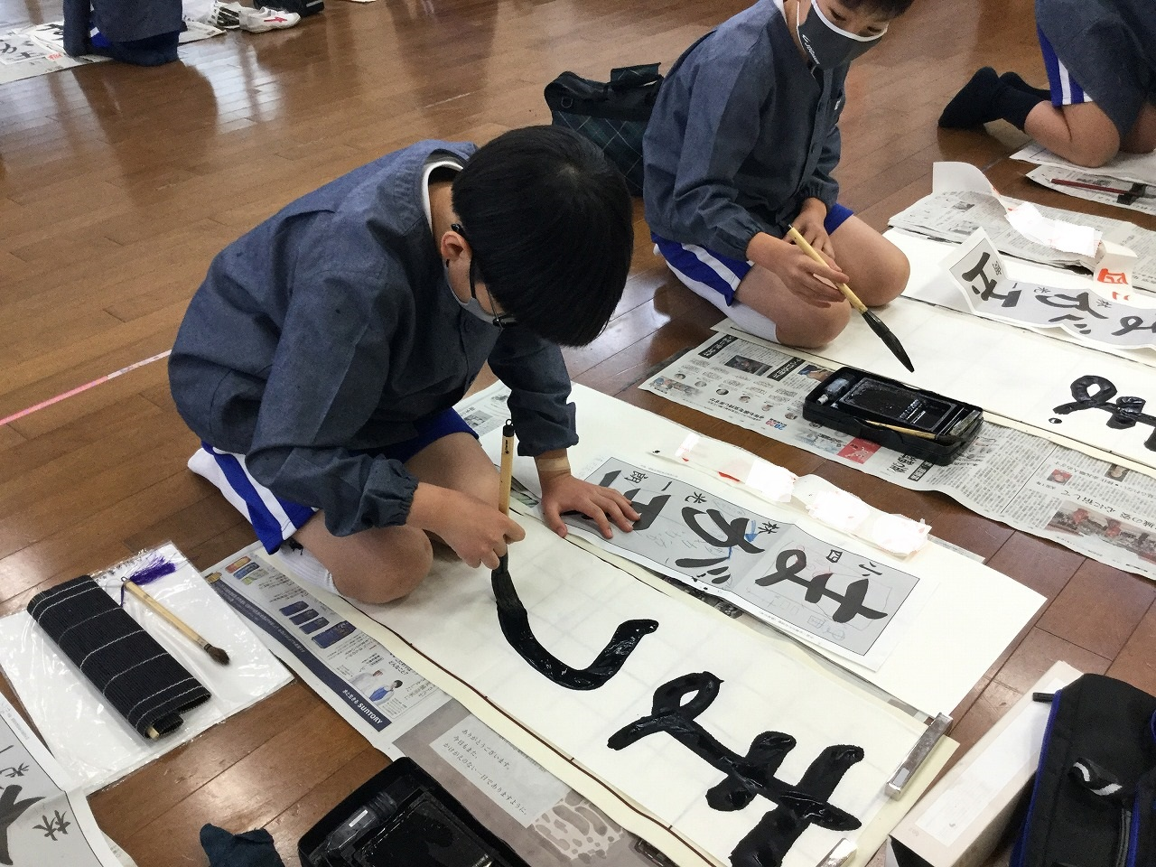
Notes:
Most Japanese people take at least three days off for New Year’s holidays.
Lots of people watch the first sunrise of the year, because it’s considered significant in Japan.
Many people buy good luck charms at shrines or temples.
Some people write their New year’s resolutions or happy words on calligraphy paper.
There are other traditional events in January.
Now, let me introduce you some of them.

Slide 23
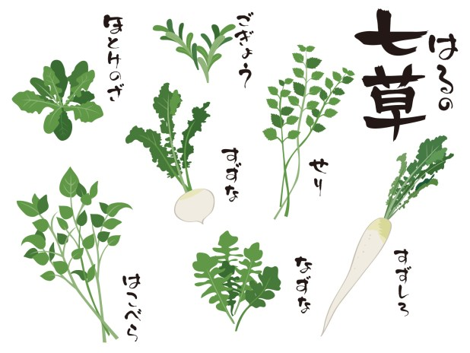
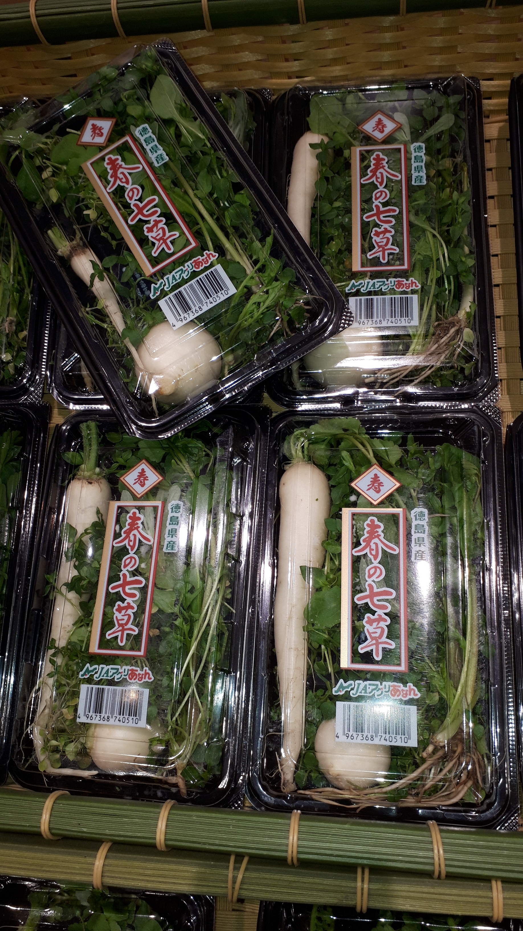
Haru-no-nanakusa
Notes:
The first event is eating nanakusa-gayu, rice porridge with seven kinds of spring herbs in the morning on the７th.
We can buy nanakusa at stores.
This event is derived from a fusion of an old Chinese custom and a Japanese aristocratic one.

Slide 24
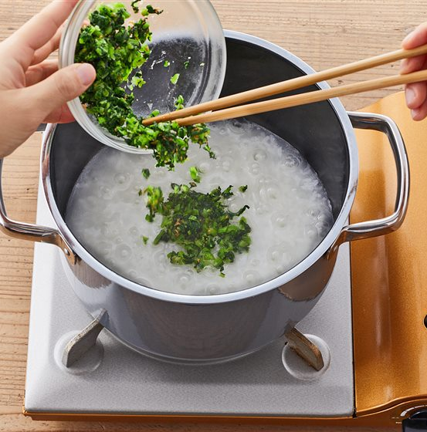
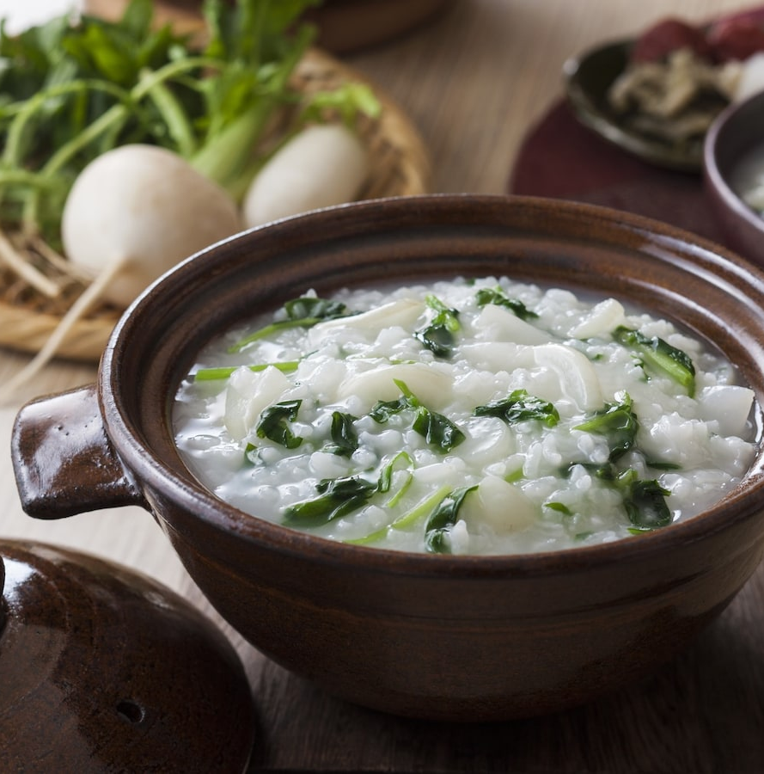
Nanakusa-gayu
Notes:
This porridge helps digestion and rests the stomach damaged by eating too much during Oshogatsu.
It is said that eating nanakusa-gayu keeps people in good health and protects us against evils all year round

Slide 25

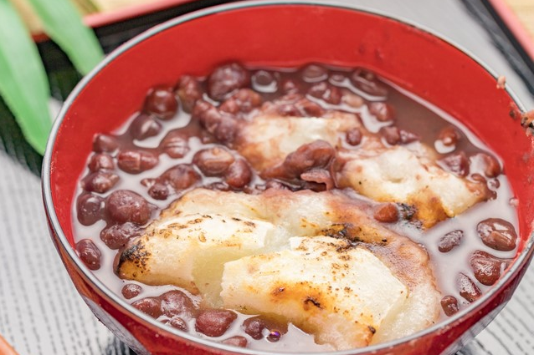
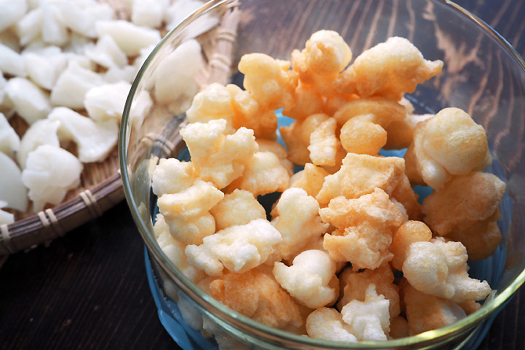
Kagami-biraki
Notes:
Next is the kagami-biraki event to send off Toshigami-sama and receive the power of gods.
Kagami-biraki means opening kagami-mochi, but actually Kagami-mochi is broken into small pieces by hitting it with a hammer or something.
Some people make sweet red-bean soup with this mochi or deep-fry this into rice cracker.
It is thought that if we eat this mochi ,we can get the power of gods.
By the way, we shouldn’t cut it with a knife.
Why ?
In olden times, cutting mochi with a knife made samurai imagine hara-kiri or the words “cut” and “break” were thought to be bad luck.
Japanese people have believed in spirits of words.
This is why they named this event Kagami-biraki without using the word “cut” or “break”.

Slide 26
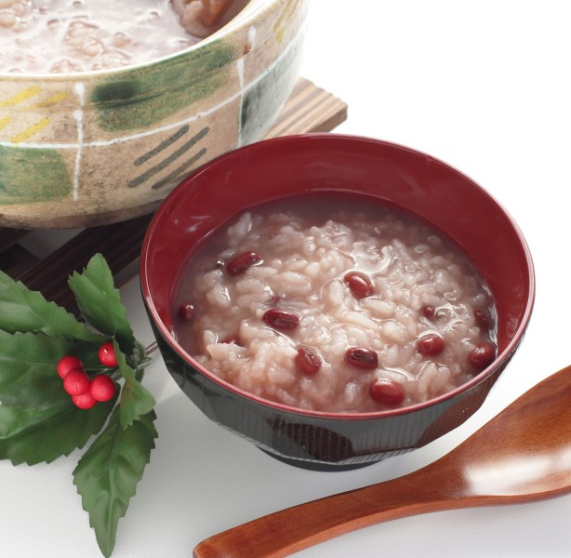
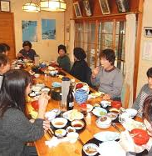
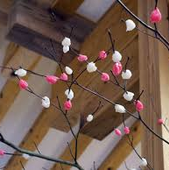
Koshogatsu
Notes:
Now, have you ever heard of Ko-shogatsu?
Ko-shogatsu is held on the 15th.
People celebrate this day not for gods but for families and pray for a rich harvest.
In some areas, people eat red-bean porridge and decorate mochi-bana like this picture.
This day is also called Onna-shogatsu,or Oshogatsu for women.
On this day women are free from their busy housework.
They spend their time having parties or relaxing .

Slide 27

Tondo-yaki
A fire festival marking the end of the New year's celebrations
Notes:
Lastly, I’ll tell you about a fire festival called Tondo-yaki marking the end of the New year’s days usually held on Ko-shogatsu.
It is believed that a big fire will drive away evil and purify ourselves and its smoke will bring us good health through the year.
People cooperate to make the fire’s base with green bamboos, straws and firewoods.

Slide 28





Notes:
The young and old gather there and burn old charms, kado-matsu and so on to see the gods off.
It is said that if the ashes of calligraphy flies high up ,their writing skill will improve.
They enjoy the big sounds of green bamboos bursting in the fire.
This event makes people’s connections stronger in their community.
When these events are over, daily lives come back to normal.

Slide 29


During the 1980’s
in the Showa era
Cars with shime-kazari ornament on the front.
Houses with the national flag
displayed at the entrance.
Notes:
The traditional New Year's customs have changed.
Let me tell you about Now and Then.
These are common scenes in the 1980s of the Showa era.
Houses displayed the national flag at the entrance, cars with Shimekazari on the front, either.
Nowadays, I hardly see these scenes in my area.

Slide 30






Koma-mawashi
Top-spinning
Hanetsuki
Sugoroku
Fukuwarai
Shuttlecock
Karuta
Make a face game
Card game
Board game
Flying a paper kite
Takoage
Traditional New Year’s games and toys
Notes:
These are traditional toys and games that used to be played on New Year’s
holidays with family members. (The make a face game is similar to pin the tail on
the donkey.)

Slide 31





Nowadays
Paper kite → Plastic kite
Top → Beyblade
Board game → Video game
Notes:
Nowadays, instead of those, children play with video games, Beyblades, plastic Kites (instead of traditional paper ones).

Slide 32







Mochi-tsuki
Bread Machine
Notes:
The annual events held at home have also changed.
Mochitsuki (pounding rice cakes) has become a public event, and the tradition of each family pounding rice with a mortar and pestle at home has almost disappeared.
Nowadays, we use various other types of equipment to make rice cakes such as in a bread machine at home.

Slide 33




Homemade
Store-bought
Notes:
Homemakers used to prepare dishes in advance for New Year’s.
In the past, as all stores were closed during the New Year holidays, everyone went out on the 30th to buy ingredients for three days’ worth of meals and made Osechi dishes.
In the past, people did not have the concept of placing an Osechi order at a department store, but now we do.

Slide 34




New Year’s allowance
Grab bags
Notes:
Nowadays stores are open for business as usual throughout the holiday period (with some closures).
People love to go to department stores to get grub bags on New Year’s Day.
As an aside, the items in the bags were secret in the past, but now there is an indication as to what kind of items are inside.
A New Year's money gift is called Otoshidama, I used to get them when I was little, and children still receive them even today.

Slide 35

Thank you for your attention!
by IIN Working Group on Cultures
Notes:
Some customs have changed and been adapted to modern times.
In this way, Japanese Oshogatsu traditions, culture, and spirit are still passed down traditionally from generation to generation.

